Slide 1
Database Final Project
Matthew Parnham

Slide 2
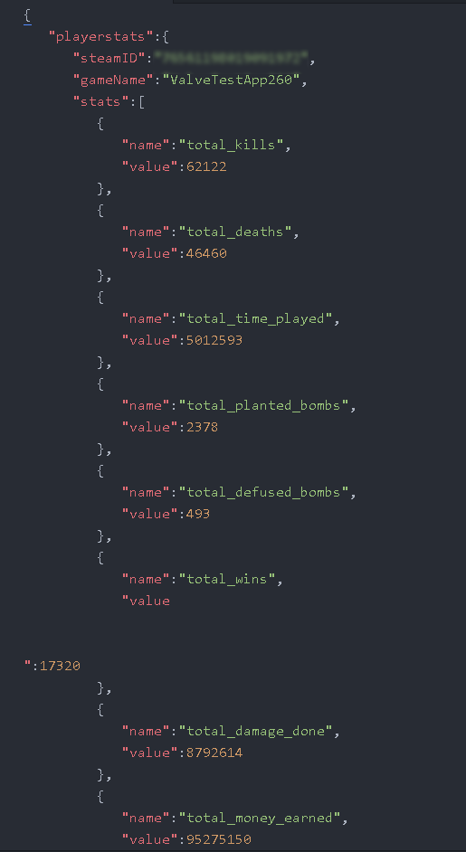
What is the Problem?
As an avid competitive FPS player, handling my data and personal stats is fundamental to success.
Popular game Counter Strike has a lot of options for this including:
Full match serialization for frame by frame replay.
The ability to save match details within the game.
An API for quickly pulling player stats.

Slide 3
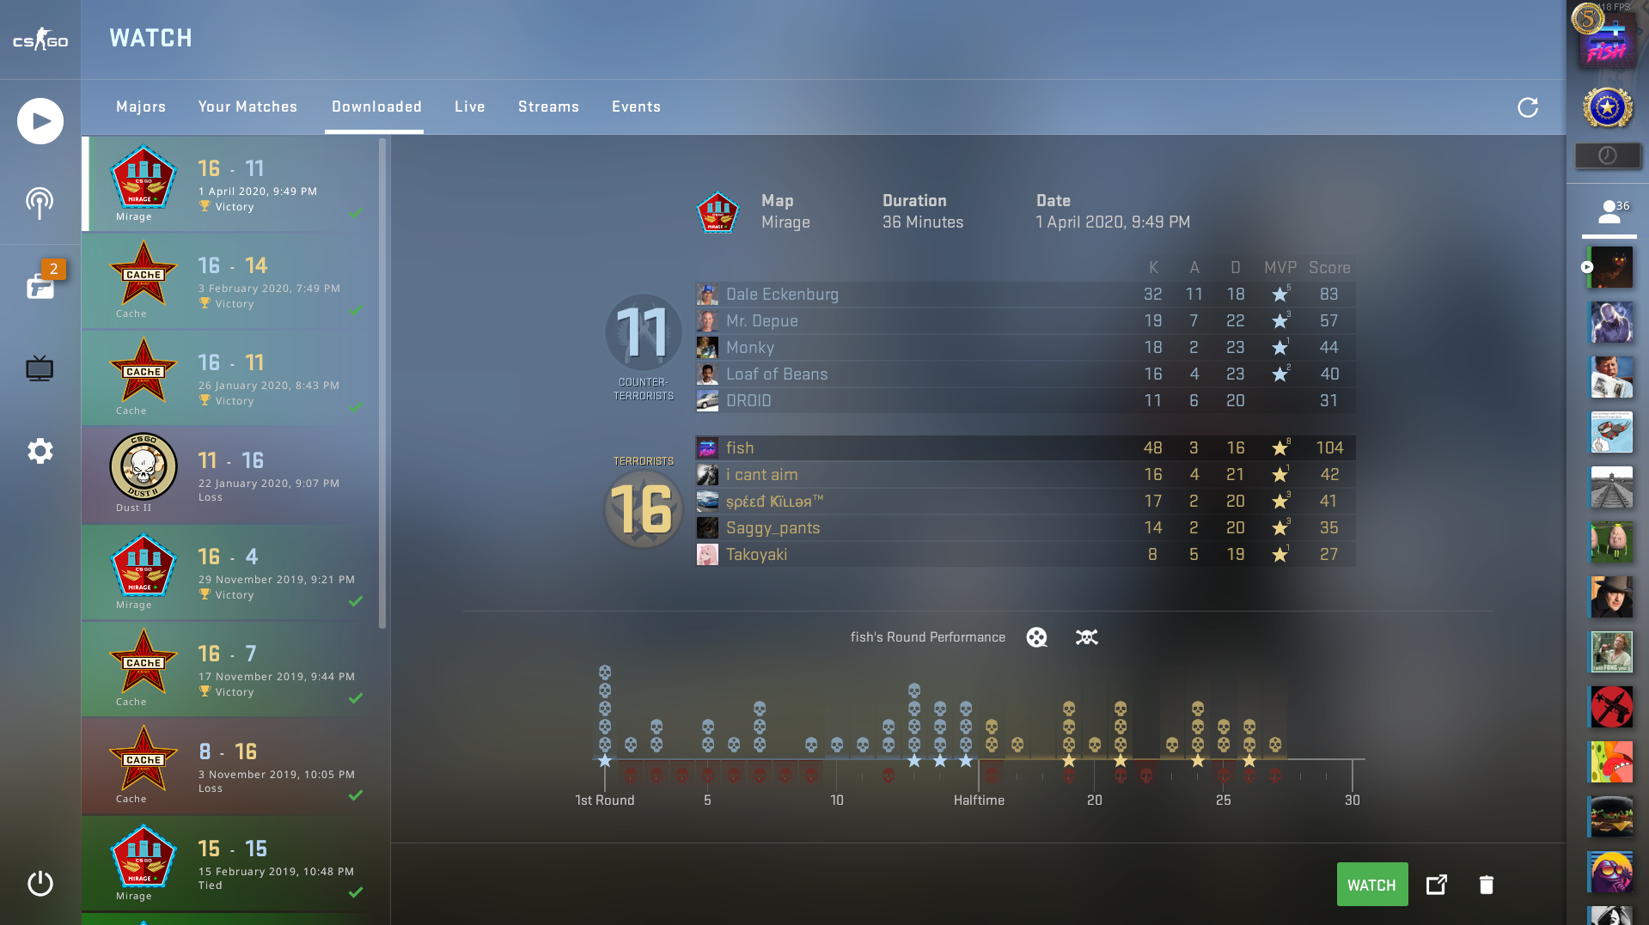

Slide 4
What is the Problem?
Valorant, a new entry in the FPS market still lacks a lot of important auditing functionality.
Match history is limited to the 10 most recent matches.
There are no overall player statistics.
The data is stuck is the game’s UI and cannot be accessed via any webhooks.

Slide 5
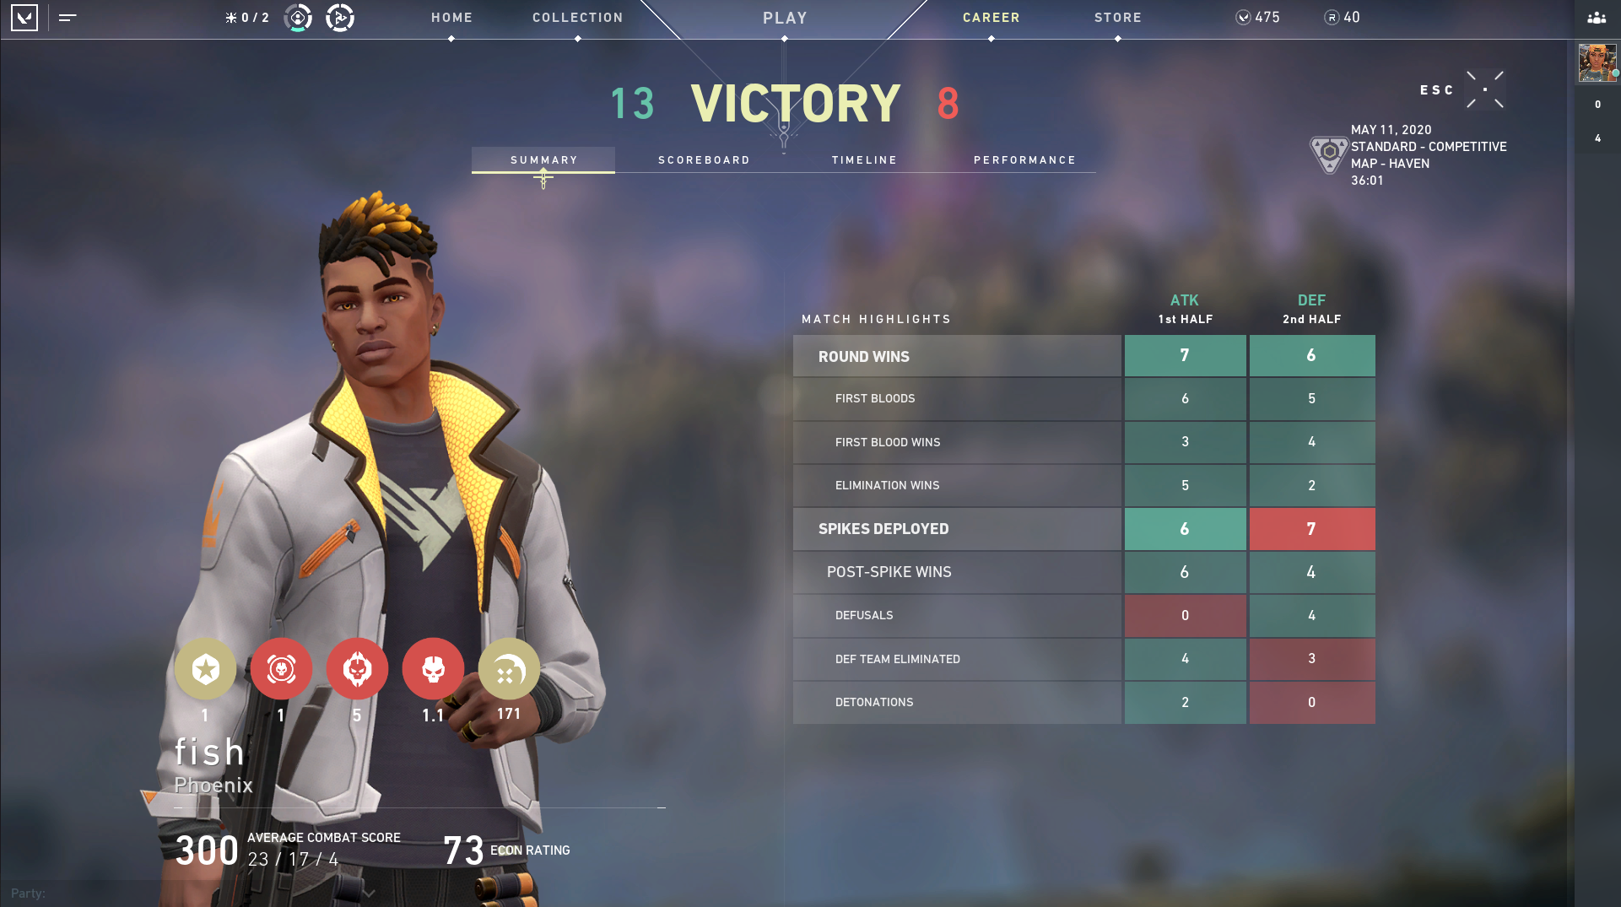

Slide 6
Research
After finding this problem, I researched to see if any solutions already existed.
It seems like everyone is waiting for an API to be released before making anything.
Riot Games has an API, but it is not yet integrated with Valorant. (https://developer.riotgames.com/)
One group has prepared a website, but not connected it to anything as no API is publicly available. (https://valorantics.gg/)

Slide 7
Solution
I set out to solve 2 problems:
Use a DBMS to store all my match data for better retention.
This would also allow me to find general stats across all my matches.
Find a way to export match data from the game without having to manually enter it all.
Manually entering it is not feasible. I tried.

Slide 8
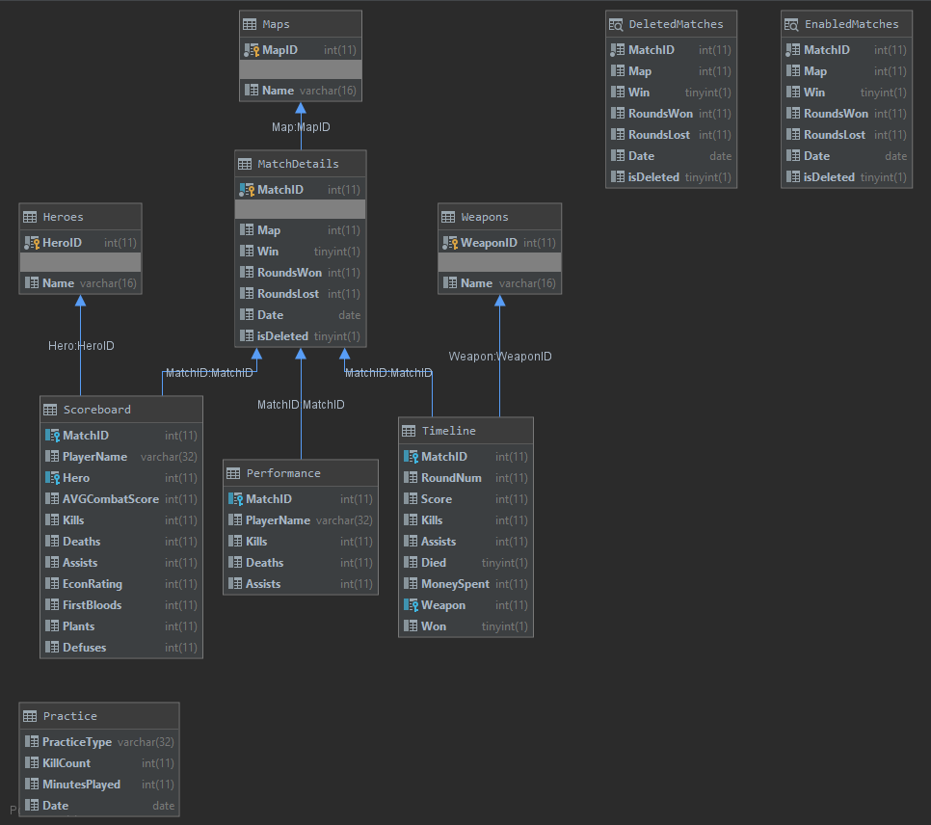
Schema:
Schema consists of 8 tables.
Intended to store all available match details for a Valorant match.
I don’t necessarily have a need for all the data right now, but for retention purposes, I’d rather have too much than too little.

Slide 9


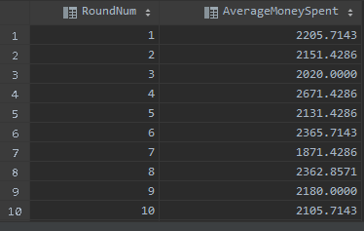

Solution
After painstakingly entering in a match manually, and generating a bunch of fake match data, I could run some initial queries and get some results.

Slide 10
Next Step
How could I get data from in the game to usable text to store in a database?
The approach I went with was parsing screenshots of the match data using OCR (Optical Character Recognition).
I used OpenCV to slice the images into a ton of tiny images containing specific points of data and Tesseract to parse text out of the images.

Slide 11
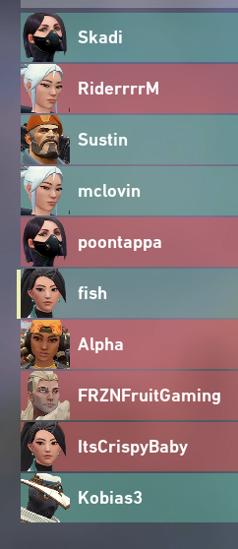

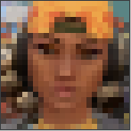
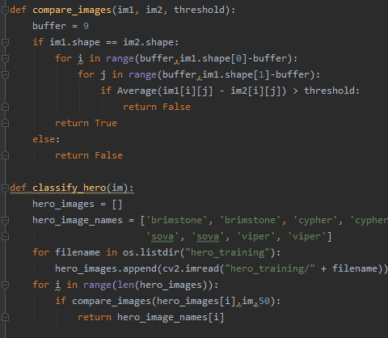
Challenges
This proved more difficult than expected for a host of reasons.
The first piece of data to parse was classifying the image of each player’s selected agent or character.
Tesseract is not meant to do this, and the overhead of overfitting a CNN to such a specific set of data was not worth it.
Instead, I wrote a small classification algorithm that compared images to premade “training” data.

Slide 12
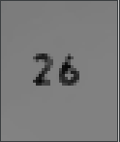
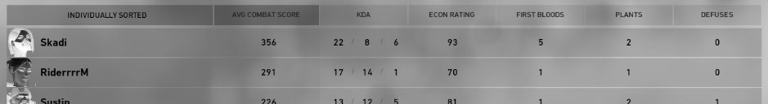
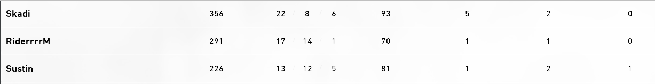
Challenges (cont.)
OCR with Tesseract is meant to be very simple.
I ran into some challenges that identified glaring flaws in the design of Tesseract.

Slide 13
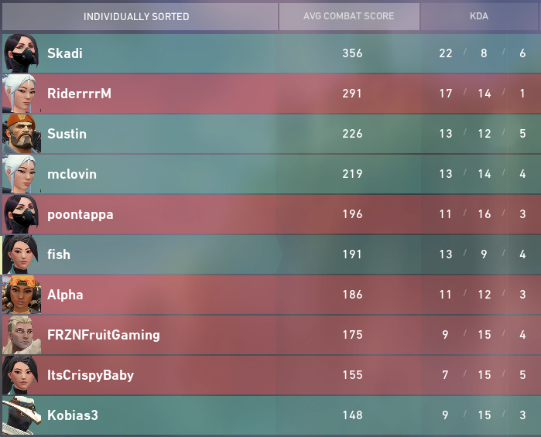
Challenges (Final)
Due to the nature of closed beta games, the font, layout, images used, and color palette of these screen has changed drastically from when I began.
Since the locations of each number on the screen need to be pixel perfect, this meant that a ton of my work had to be restarted.
Hero | Name | ACS | Kills | Deaths | Assists
Viper | Skadi | 356 | 22 | 8 | 6
Jett | RiderrrrM | 291 | 17 | 14 | 1
Brimstone | Sustin | 226 | 13 | 12 | 5
Jett | mclovin | 219 | 13 | 14 | 4
Viper | poontappa | 196 | 11 | 16 | 3
Sage | fish | 191 | 13 | 9 | 4
Raze | Alpha | 186 | 11 | 12 | 3
Sova | FRZNFruitGaming | 175 | 9 | 15 | 4
Sage | ItsCrispyBaby | 155 | 7 | 15 | 5
Cypher | Kobias3 | 148 | 9 | 15 | 3
Original
Scoreboard
OCR Parsed
Scoreboard

Slide 14
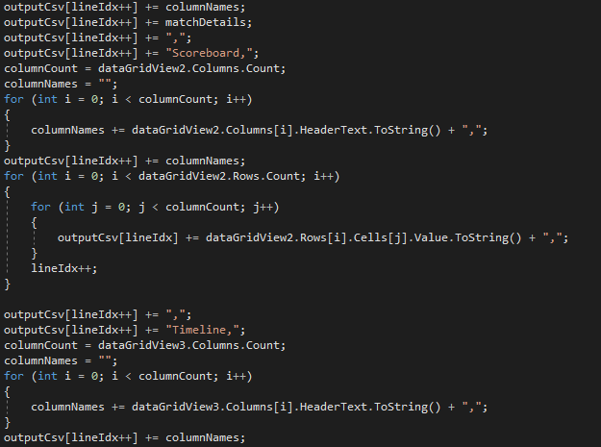
Moving on
I opted to build a winform application in C#.
Since I plan on actually using it, I wanted ease of access.
Windows forms checked all the boxes.
I fired up Visual Studio and got to work.

